Slide 1

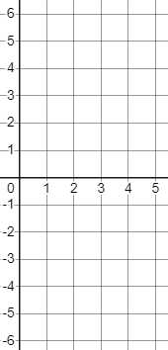




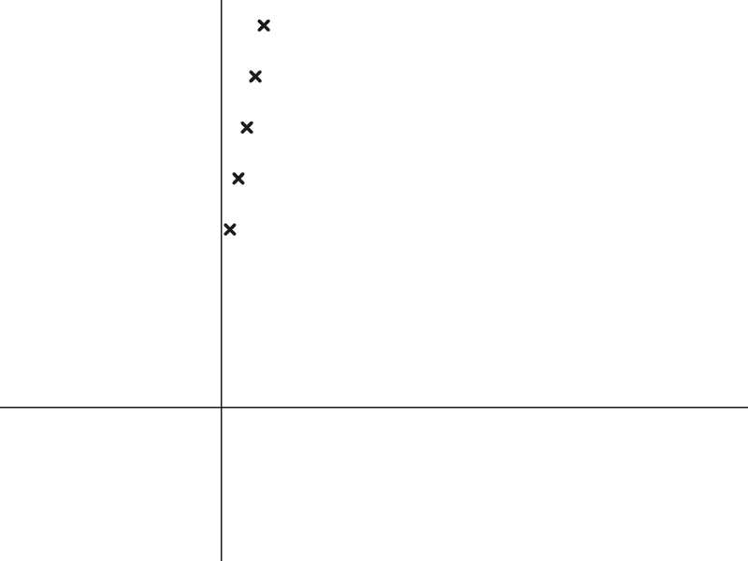
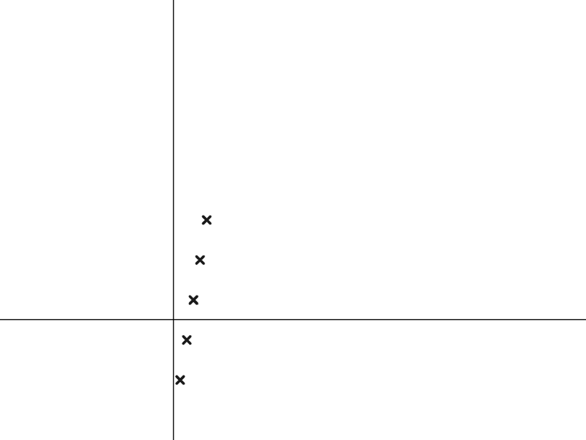
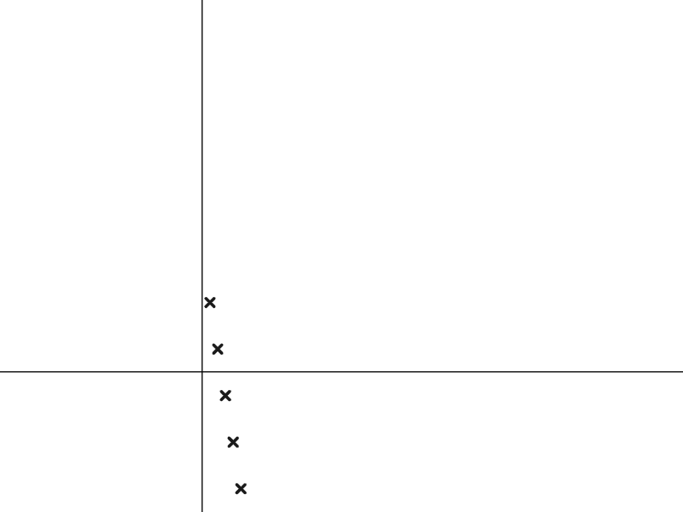
Representing sequences graphically
Task A: Plotting arithmetic sequences
1) Find and plot the first five terms of these arithmetic sequences.
a)
Term number (n) | 1 | 2 | 3 | 4 | 5
Term value (T) | -6 | -3 | 0 | 3 | 6
Term value
Term number
b)
Term value
Term number (n) | 1 | 2 | 3 | 4 | 5
Term value (T) | 2 | 1 | 0 | -1 | -2
Term number
2) Match the sequences to their graph.

Slide 2


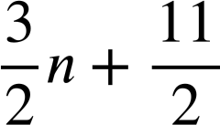

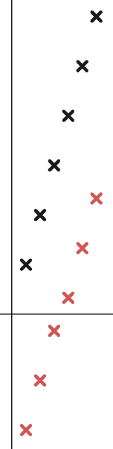
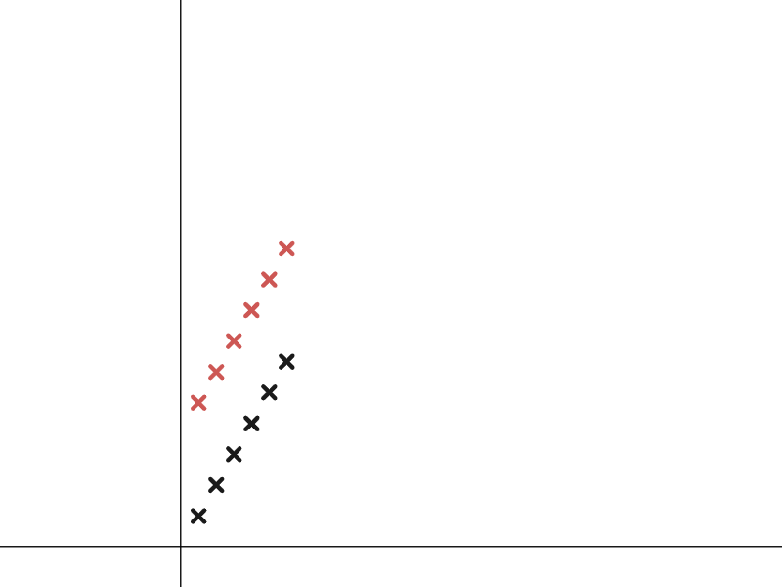
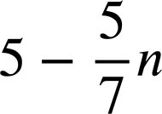
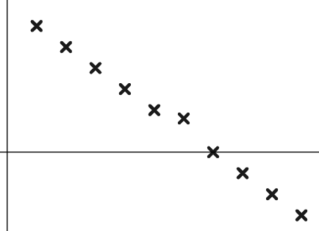

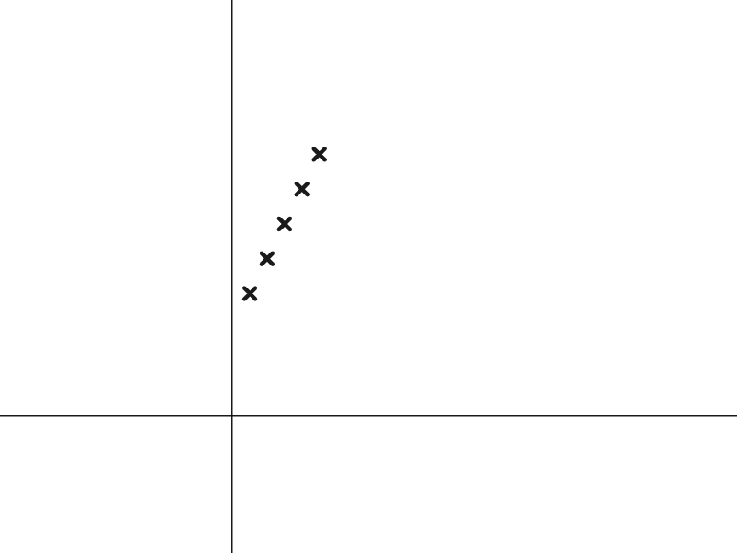



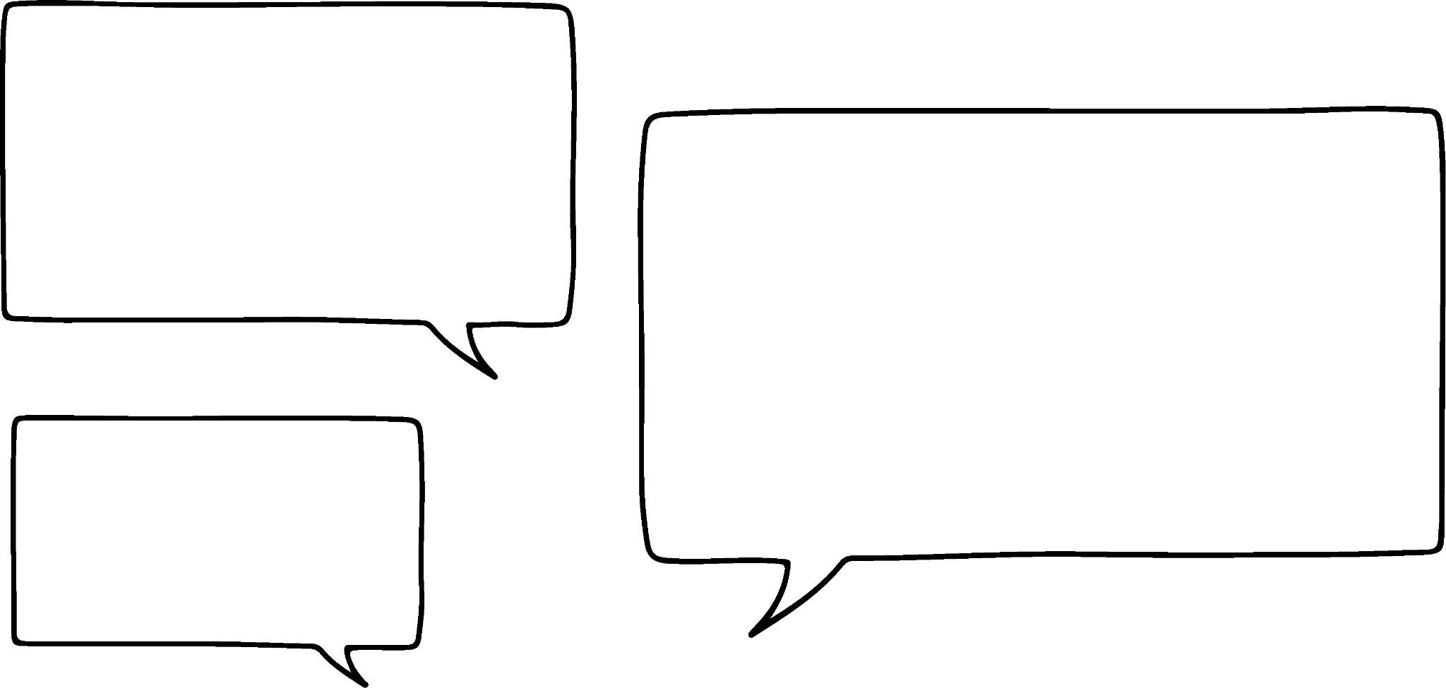

Representing sequences graphically
Task B: Features of sequences represented graphically
1) a) Match these arithmetic sequences to the correct plotting.
b) Write a few sentences explaining how you identified each sequence.
2) Izzy has plotted the sequence
Term value
Which term number is wrong? Write a sentence to justify your answer.
Term number
3) a) Sofia has started to draw the structure of the arithmetic sequence 2n + 5
Finish her diagram for her.
b) Write a sentence explaining why this structure represents the sequence 2n + 5
Term value
Term number
4) The 10th term of the arithmetic sequence 3.5n is 35 and the 20th term is 70 so Laura says…
I know the 10th term of the arithmetic sequence 3.5n − 21 is 14 so the 20th term must be double that. It’s 28
Explain to Laura why this does work for the arithmetic sequence 3.5n but it doesn’t for the sequence 3.5n − 21
Mathematics in Education and Industry
v2.1

